Slide 1

Learning about loss and bereavement
Lesson resource for KS2
Lesson 1 of 2
Developed in conjunction with Brighton & Hove City Council PSHE Team

Slide 2

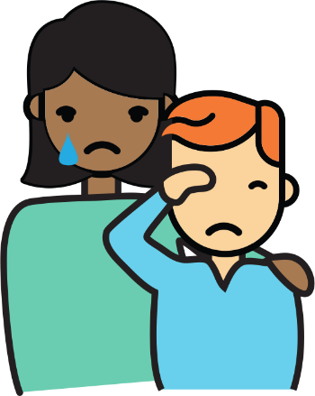
Lesson 1
?
Our learning question:
How could loss and bereavement affect someone’s feelings?

Slide 3

How can we make sure everyone feels safe and valued in this lesson?

Slide 4

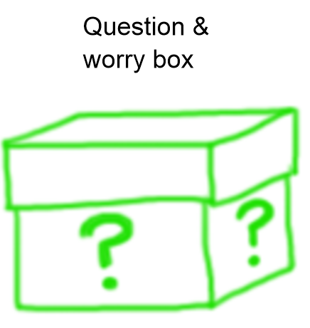
How can we make sure everyone feels safe and valued in this lesson?
Confidentiality
Listen to each other
Remember that everyone has the right to be heard and their opinion/beliefs respected
Ask a question if you feel confused
Ensure everyone has their chance to speak and avoid comments that may be harmful to others
We have the right to pass
Be kind and respectful to anyone who does share feelings or thoughts today
Anything else that would help us to keep everyone feeling safe and valued?

Slide 5
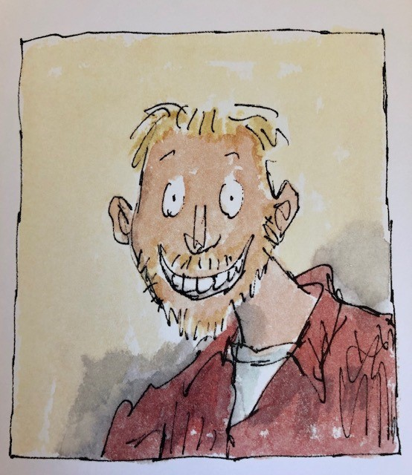
How is Michael Rosen feeling?

Slide 6
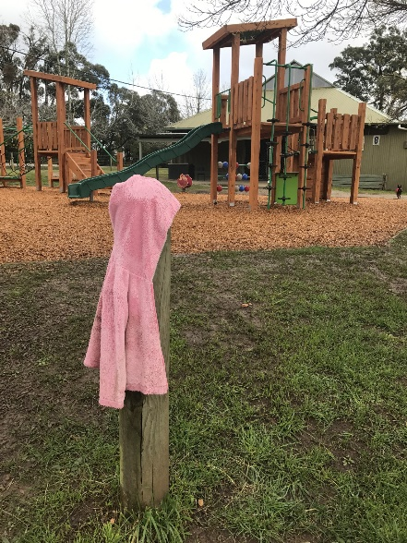
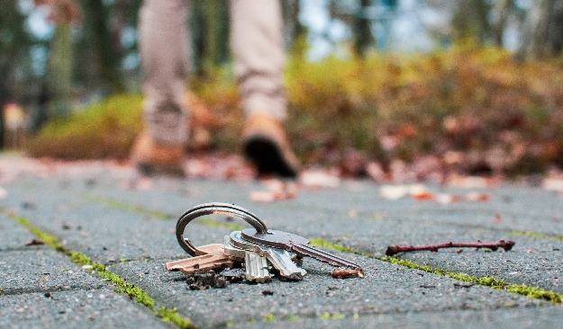
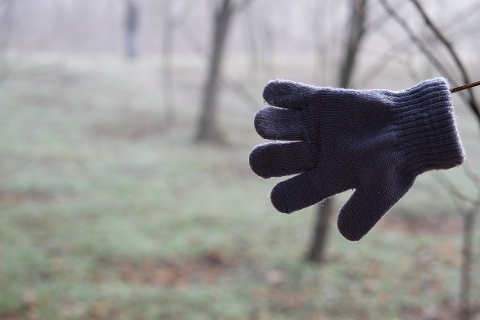

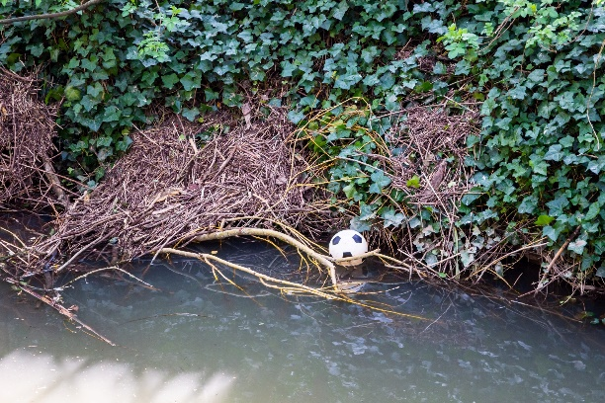
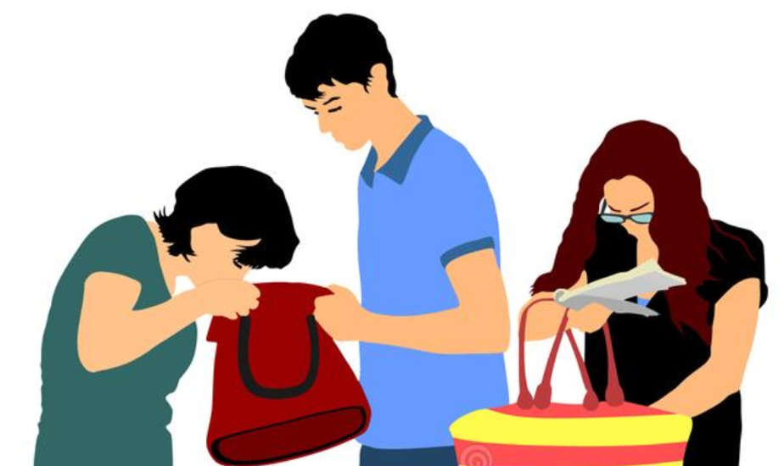

What objects do we lose?

Slide 7
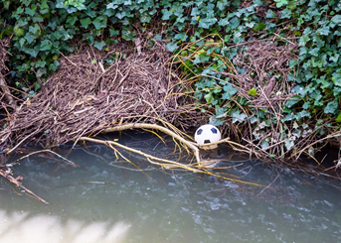
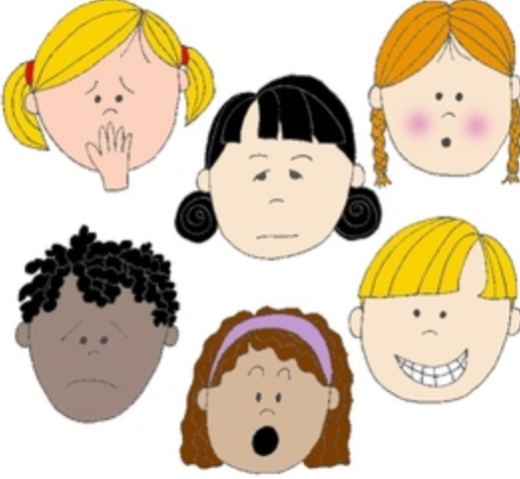



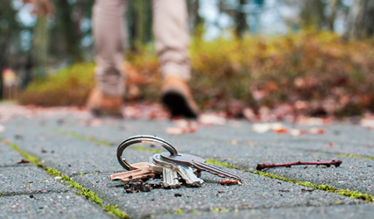
Q. How do you think someone would feel if they lost the item in the picture?
Q. What could they do to cope with this loss?

Slide 8
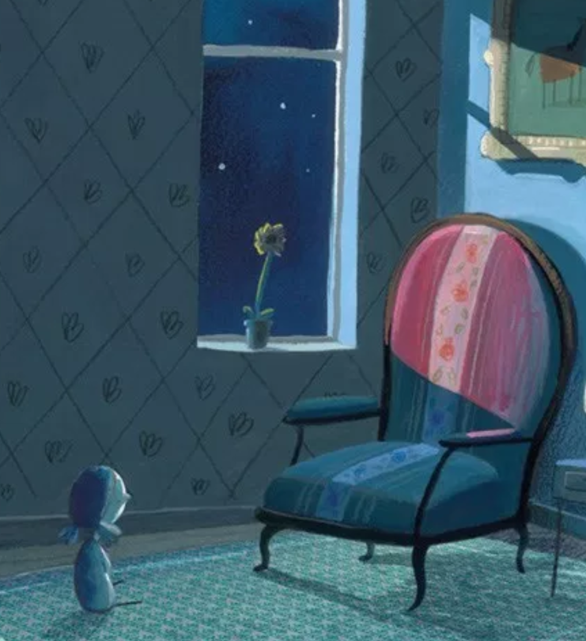
Feelings and loss and grief
Losing a treasured object or useful possession can be annoying, painful and upsetting.
This gives us a tiny glimpse into how painful the feelings of loss are when a pet or person dies.

Slide 9
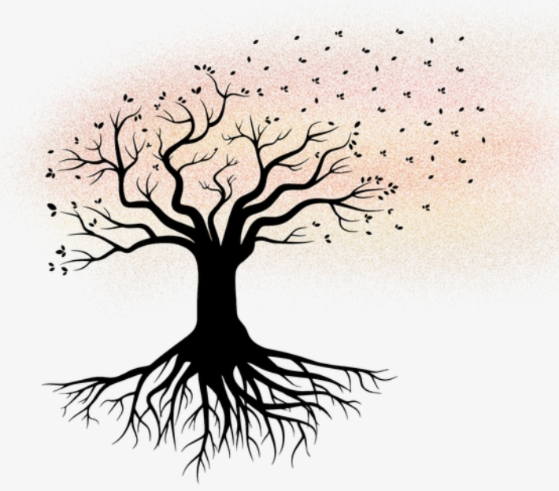
Let’s warm up our thinking!
The child has lost their teddy.
Tadek lost his dog.
We lost four months of school during COVID-19.
Ahmed lost his grandfather.
Paulina got lost in the supermarket.
Sam was feeling a bit lost with his maths homework.
Daniel lost his front teeth after an accident.
Discuss with your talk-partner what these sentences mean.

Slide 10





Match the words and definitions
Loss
Bereavement
is the term to describe the experience of having someone important die
Grief
is the way someone feels, including intense sadness and a range of other feelings, after someone has died
the fact or process of losing something or someone

Slide 11
Match the words and definitions
Loss
Bereavement
is the term to describe the experience of having someone important die
Grief
is the way someone feels, including intense sadness and a range of other feelings, after someone has died
the fact or process of losing something or someone

Slide 12



Growing our understanding of the feelings of grief and loss
The story includes the death of a loved grown up.
The main character has happy and sad feelings.
The story has a hopeful ending.
You might have strong or difficult feelings listening to the story and that is OK.
It is ok to ask for help or ask questions if you need to.

Slide 13
First responses
What are your first thoughts about the story?
What did you like?
What didn’t you like?
Can you explain what happened in the story?
Can you describe the feelings in the book?
Do you have any questions about the story?

Slide 14
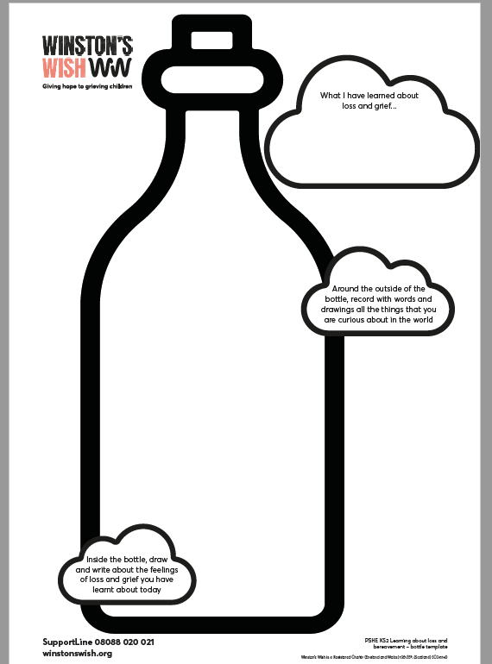
Let’s fill our bottles
Draw and write the feelings that were in the story.

Slide 15
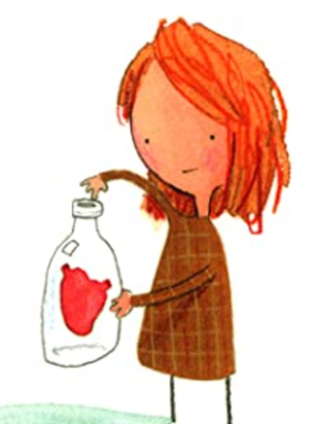
Do you agree or disagree?
Agree__________ Disagree
If you hide your sad feelings, you won’t feel upset anymore.
It is OK to be sad, and it can help to cry, and share your feelings.
It is OK to be happy sometimes when someone you loved has died.

Slide 16
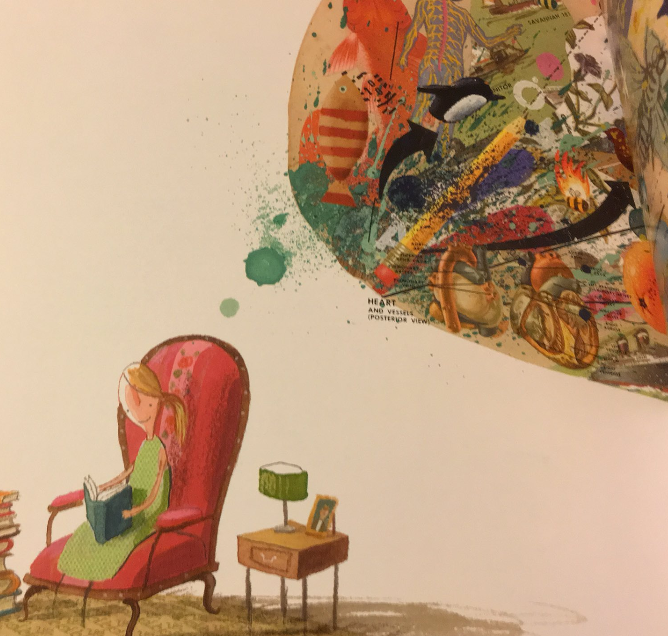
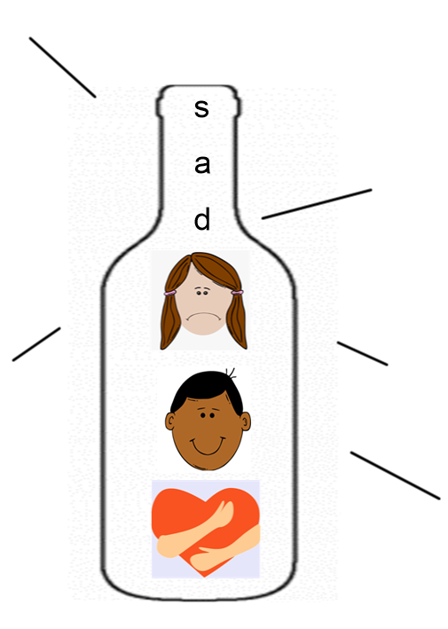
At the end of the story the young girl unlocks her heart from the bottle and re-discovers her joy and curiosity in the world.
Write all the things you are curious about, interested in or make your feel joy around the outside of the bottle.

Slide 17
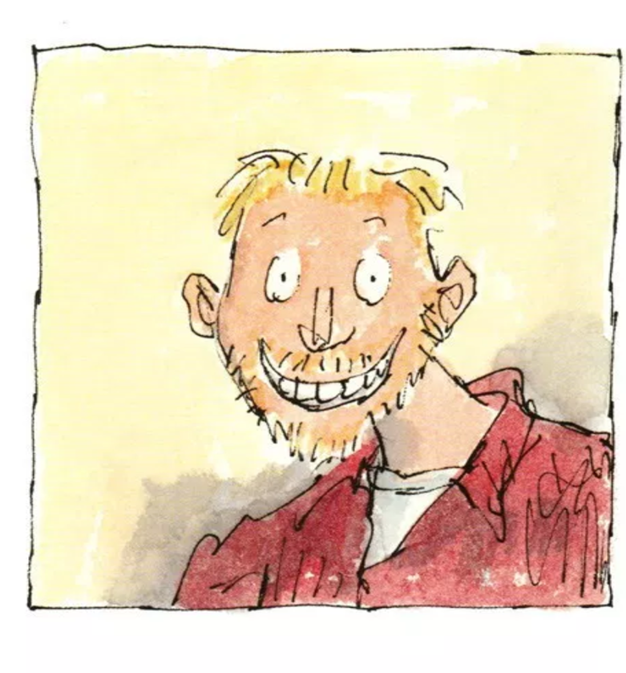
How has our learning grown today?
What have you found out about loss and how a bereavement can affect someone’s feelings?
I have found out that loss can make someone feel …
What have you found out about what helps with sad feelings?
I have found out that…

Slide 18
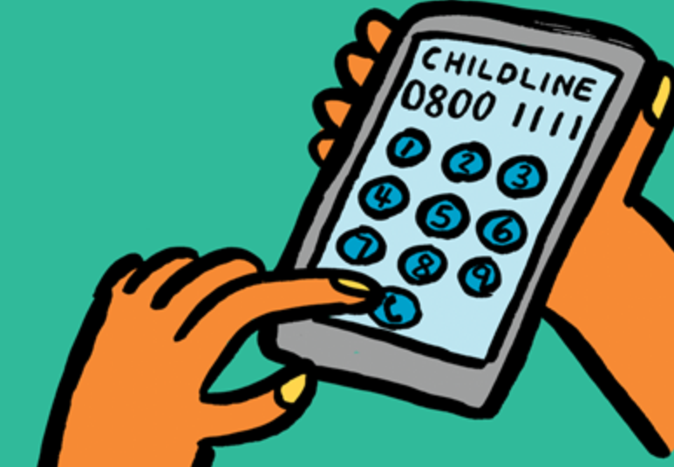


It’s OK to ask for help
If you are left with strong feelings or if you have a question, who could you talk to?
Who could you talk to in school?
Contact Childline or your parent/carer could get in touch with Winston’s Wish:
By phone: 08088 020 021
By email:
ask@winstonswish.org
By online chat: https://www.winstonswish.org/online-chat/
“We can talk with someone about anything, even if it feels awful or small”
It’s OK to ask for help

Slide 19

Let’s do some calming breathing to finish our lesson
Relaxation activity
Deep inhale
Hold your breath & smile
Deep exhale

