Slide 1
Learning about loss and bereavement
Lesson resource for Key Stage 2
Lesson 2 of 2
Developed in conjunction with Brighton & Hove City Council PSHE Team

Slide 2
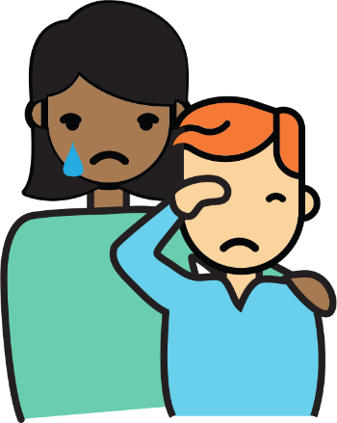
Lesson 2
?
Our learning question:
How can we handle our feelings about loss?

Slide 3
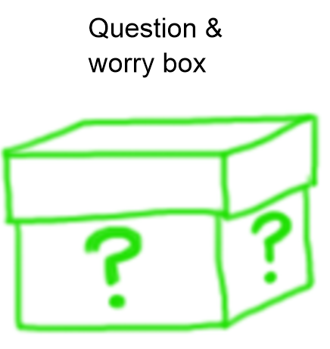
How can we make sure everyone feels safe and valued in this lesson?
Confidentiality
Listen to each other
Remember that everyone has the right to be heard and their opinion/beliefs respected
Ask a question if you feel confused
Ensure everyone has their chance to speak and avoid comments that may be harmful to others
We have the right to pass
Be kind and respectful to anyone who does share feelings or thoughts today
Anything else that would help us to keep everyone feeling safe and valued?

Slide 4
Let’s recap our learning
What did we learn about in our last lesson?
What happened in the story?
How did the girl try to manage her sad and painful feelings about the death of someone important in her life?
Did she feel better?

Slide 5
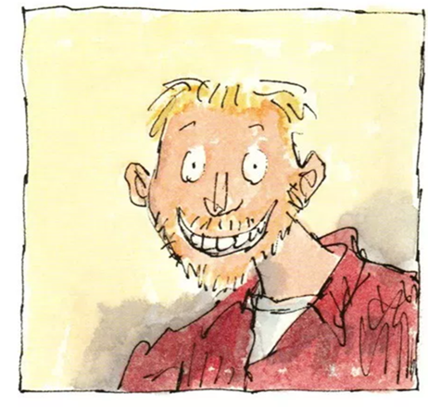
Growing our understanding of the feelings of grief and loss
Listen carefully to this story.
The book includes descriptions of the loss through death of important, loved family members.
The author describes a range of feelings.
The book has suggestions about how to handle feelings of sadness and grief.
You might feel strong feelings too and that is ok. It is OK to ask for help or ask questions.

Slide 6
First responses
What did you like about the book?
Was there anything you didn’t like about the book?
What would you say about the book to someone who has not read it?
What have your learned from the book?
Was there anything that surprised you in the book?

Slide 7
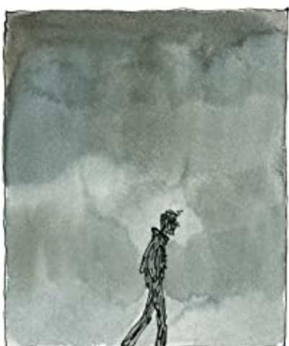
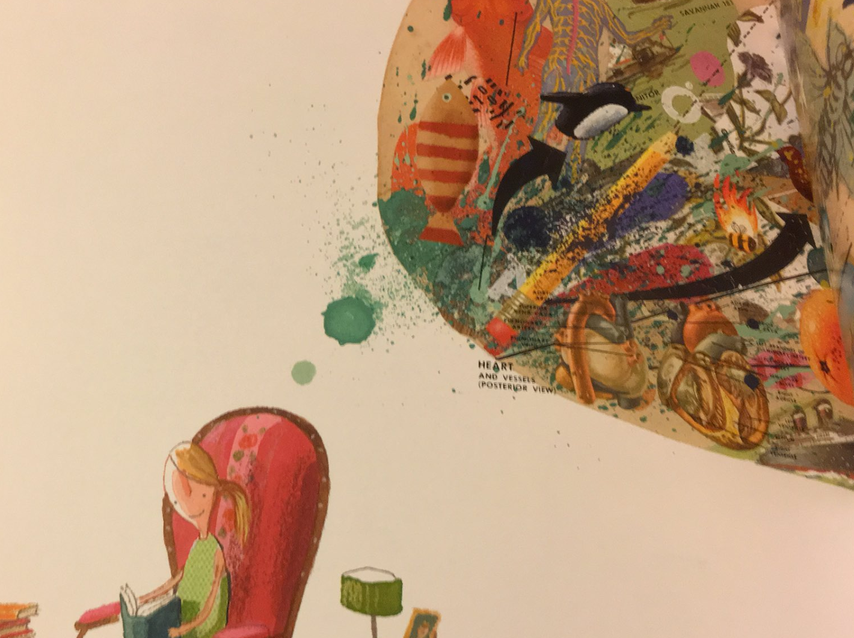
Understand feelings of loss and grief
Some experts have suggested that although someone’s feelings of grief will stay the same, over time, their life, experiences and moments of enjoyment will grow around their feelings of loss and grief.
In his Sad Book, Michael Rosen describes that sometimes he feels like sad is very big and everywhere.

Slide 8
Growing around grief (Version A)
To begin with, grief feels as if it takes up all of the room inside us. There’s no room for anything else.
After a while, people find that they can do and feel other things.
There’s a bit of room for feeling happy and having fun.
After more time, people may find that they have room for lots of feelings, for doing and learning new things.
The ball hasn’t shrunk. It’s the same size. The space around it has got bigger.
Grief doesn’t get smaller, but we grow around it.

Slide 9
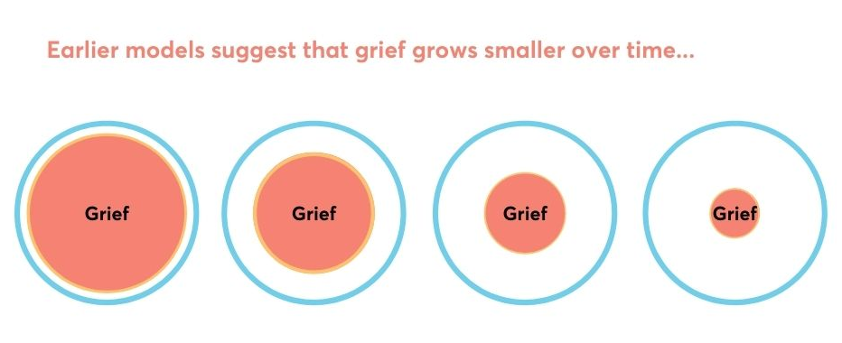
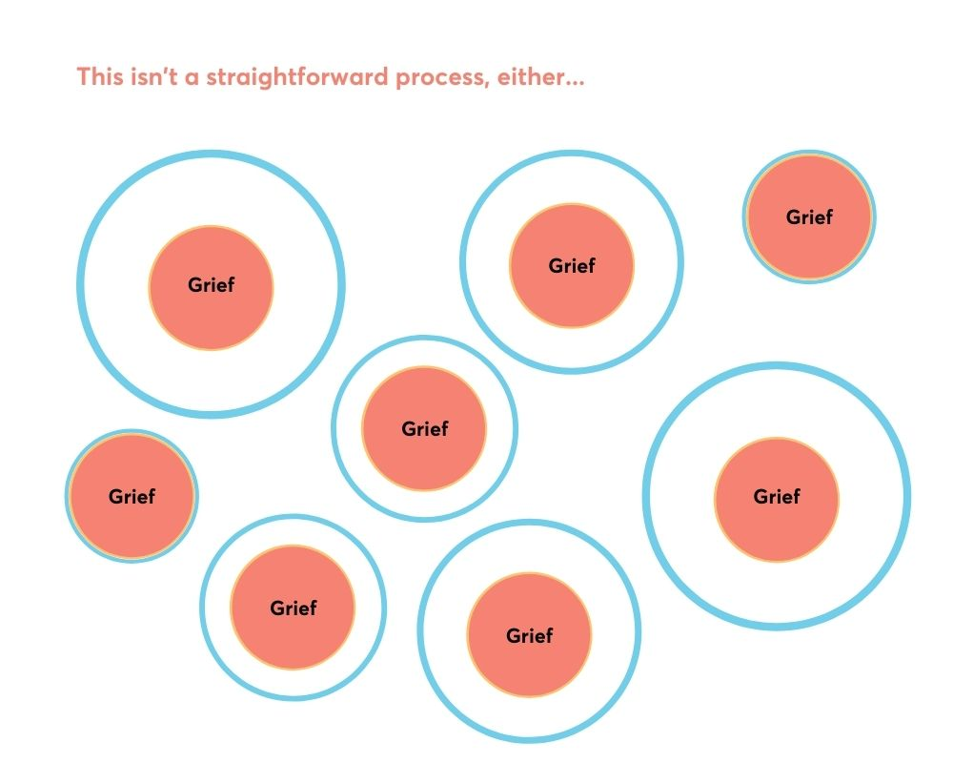
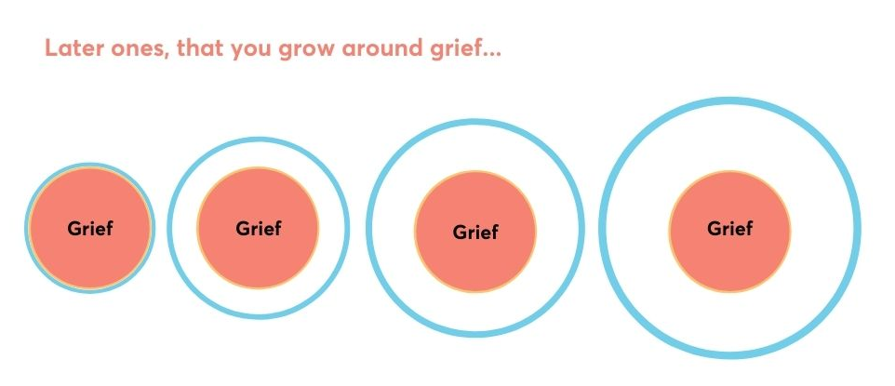
Growing around grief (Version B)
Tonkin, L. Growing around grief - another way of looking at grief and recovery Bereavement Care Volume 5, 1996, Issue 1

Slide 10
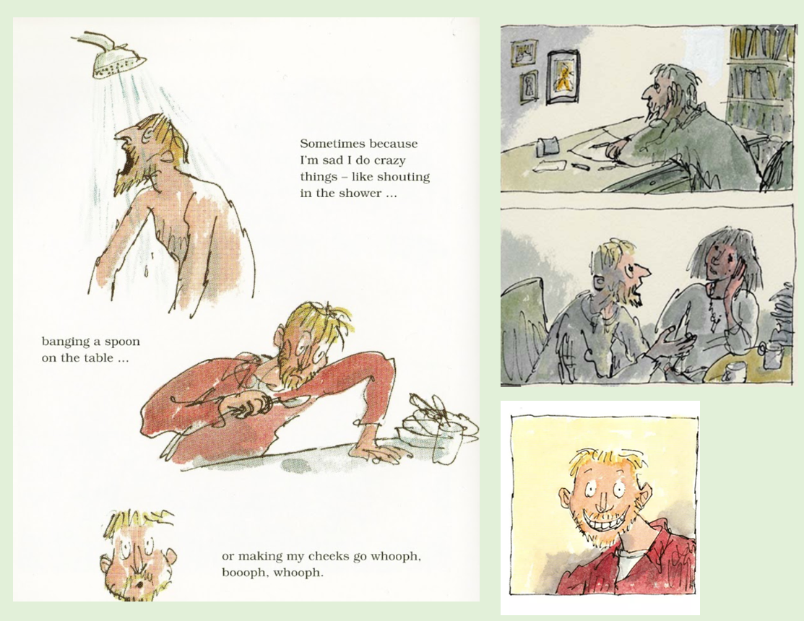
In the story, Michael Rosen describes his feelings of loss and grief about the death of his son and his mum.
He also talks about the strategies he uses to help him cope and manage these feelings.
Which ones can you remember?

Slide 11
Coping strategies in the Sad Book
Banging a spoon on the table
Shouting in the shower
Writing about feelings
Talking to others
Being alone
Doing something that feels good every day
Lighting a candle
Looking at photos and remembering
Thinking of something to be proud about every day
Best strategy

Slide 12
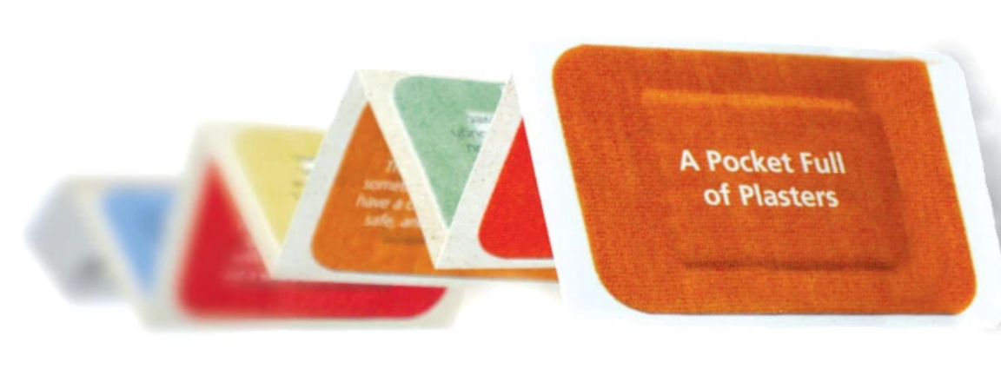
Creating our own ‘A Pocket Full of Plasters’
Childhood bereavement charity Winston’s Wish suggests using ‘A Pocket Full of Plasters’ as a way of coping with difficult feelings. Each ‘plaster’ has an idea of something that might help. It has 10 'plasters' of advice that young people can think about when they are hurting.
Using the ‘A Pocket Full of Plasters’ template, record your ideas on the ‘plasters’ that you can keep as reminders of things that can help with difficult feelings
You can choose from Michael’s ideas, the Pocket Full of Plasters and add some of your own.

Slide 13
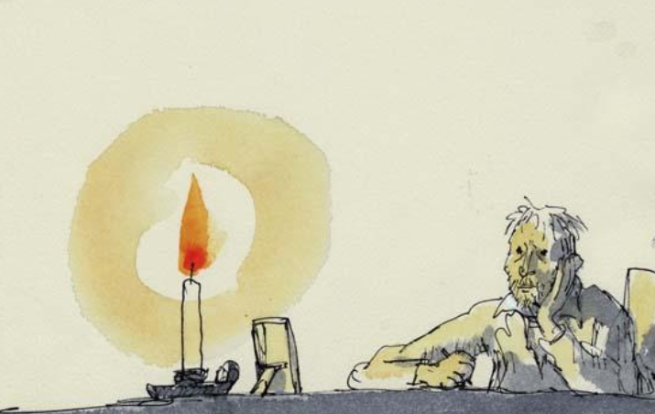
How has our learning grown today?
Aisha has a friend called Zuzanna. Zuzanna’s granny died a month ago.The funeral was in Poland and Zuzanna did not go. Aisha notices that Zuzanna is by herself in the playground and looks very sad.
Work with a partner to write a conversation which shows how Aisha supports Zuzanna.
Try to use all your learning from the last two lessons.

Slide 14
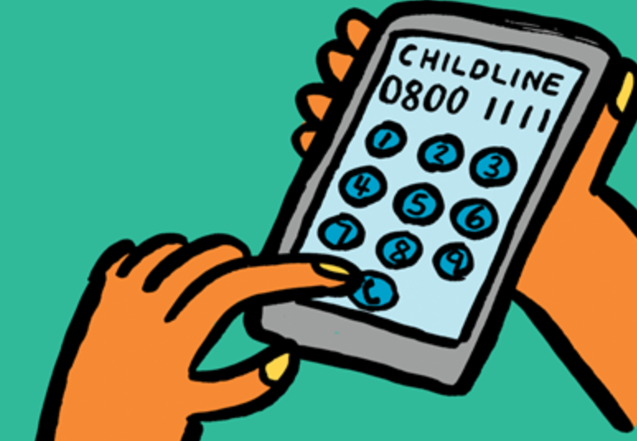
It’s OK to ask for help
If you are left with strong feelings or if you have a question, who could you talk to?
Who could you talk to in school?
Contact Childline or your parent/carer could get in touch with Winston’s Wish:
By phone: 08088 020 021
By email:
ask@winstonswish.org
By online chat: https://www.winstonswish.org/online-chat/
“We can talk with someone about anything, even if it feels awful or small”

Slide 15
Let’s do some calming breathing to finish our lesson
Relaxation activity
Hold for 4
Breathe out for 4
Breathe in for 4
Hold for 4
Start here

Slide 16
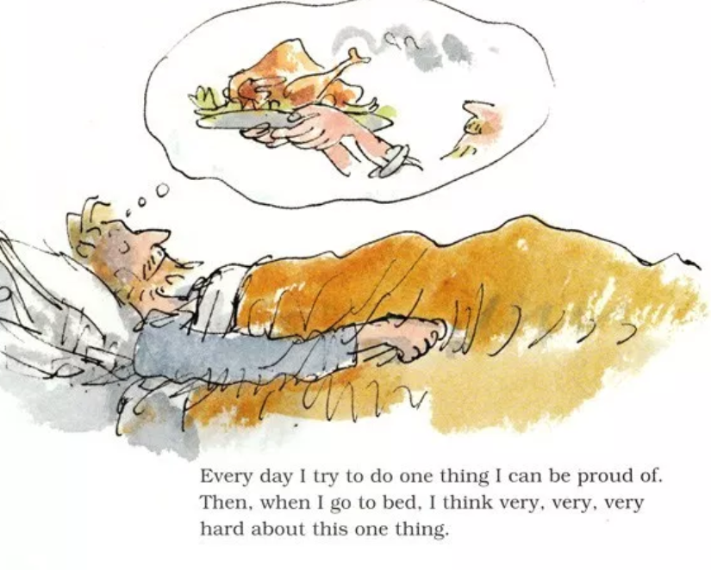
Three good things
Michael Rosen talks about thinking about something positive that has happened each day as part of his coping strategy.
Scientists have found out that feeling grateful can help us to grow our well-being and feel happier.

